Slide 1
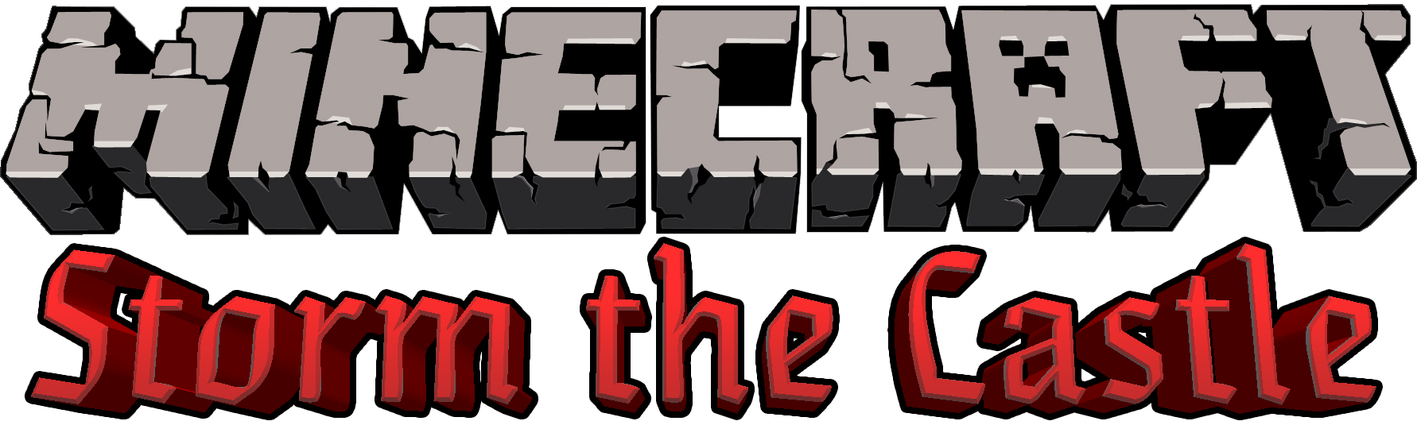

Slide 2
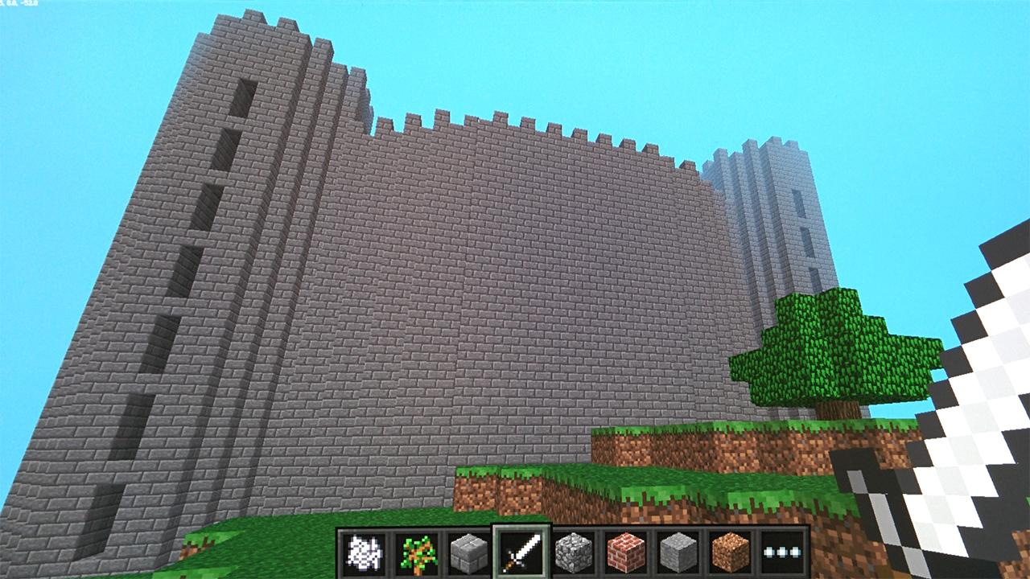

Slide 3
Hello, World!
In the Minecraft chat

Slide 4
Getting Started
Open IDLE
File > Open
Minecraft-Scripts -> my-scripts -> helloworld.py

Slide 5
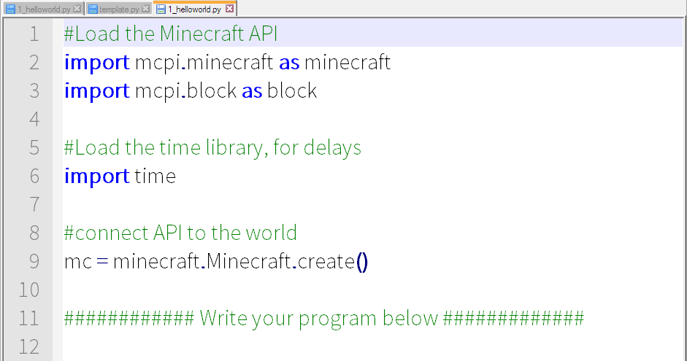
Don’t Panic

Slide 6
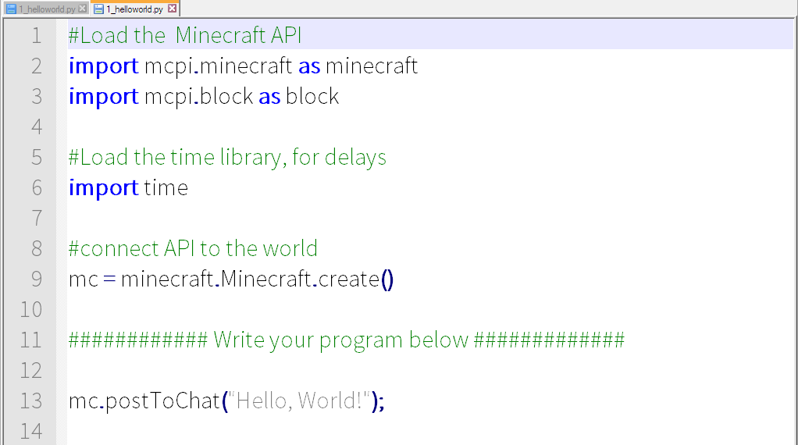
Hello, World!

Slide 7
Running “Hello, World!”
Make sure Minecraft is running (in-world)
Save your file (File -> Save)
Run the Program (Run->Run Module OR Press F5)

Slide 8
Midas Touch
Changing a block

Slide 9
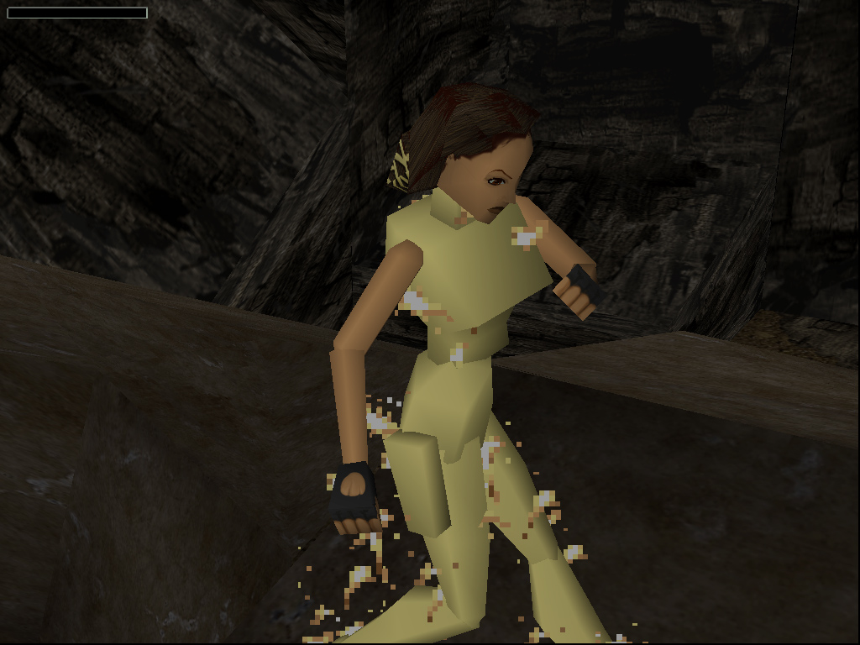
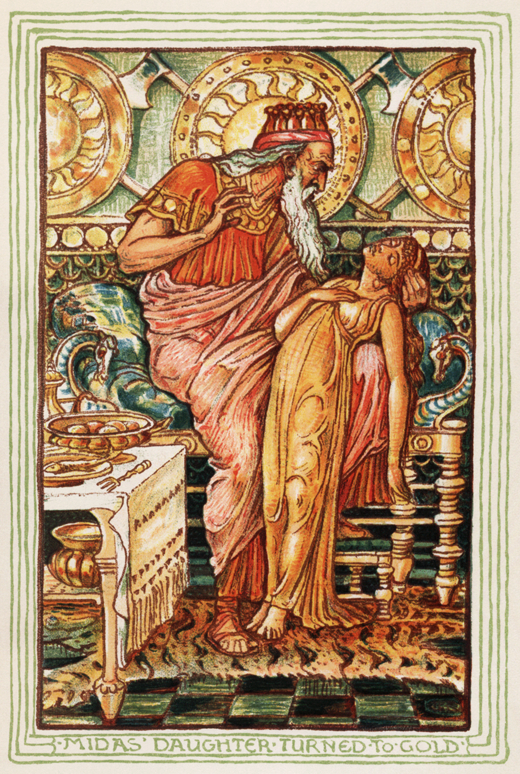
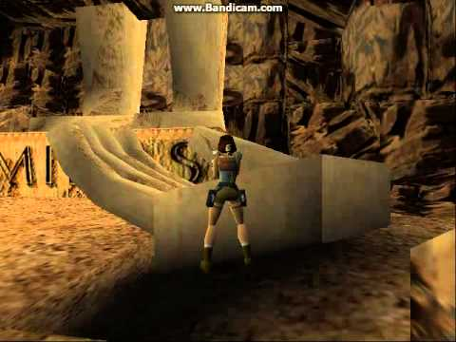
Midas Touch
In Greek mythology, King Midas turned everything he touched into gold
Let’s do the same thing in Minecraft

Slide 10
What do we want to do?

Slide 11
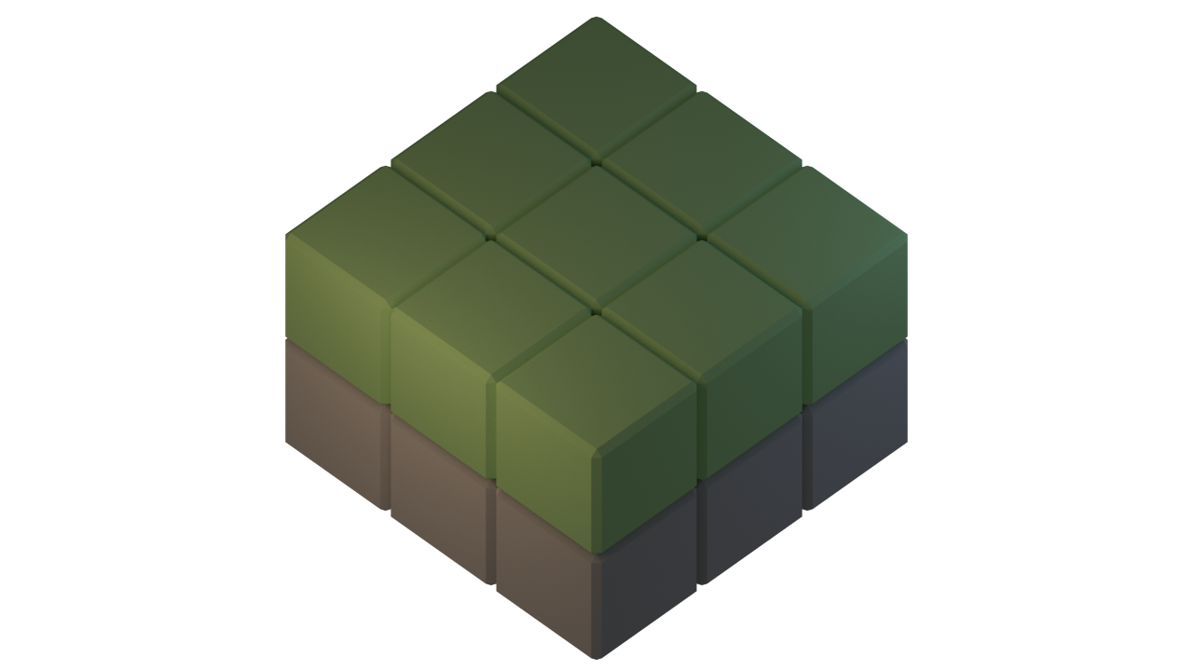

Slide 13
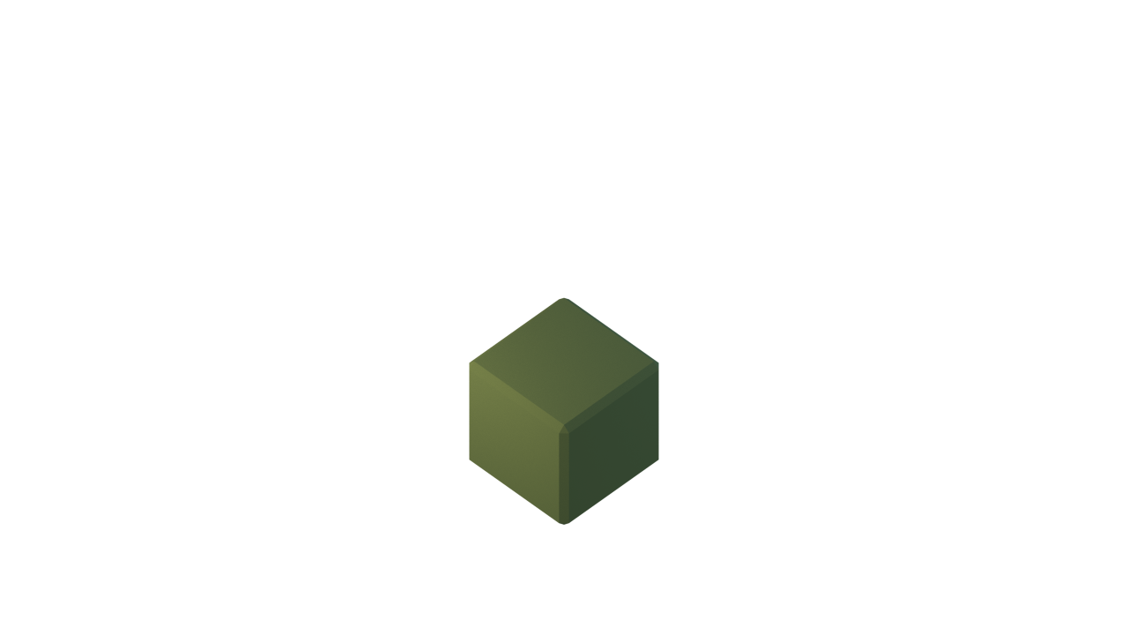

Slide 14


Slide 15
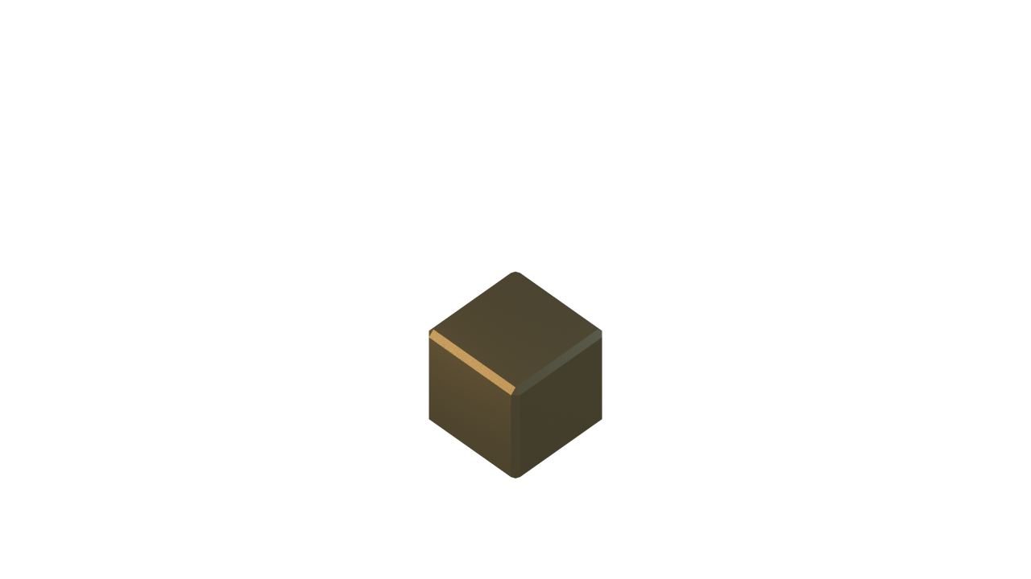

Slide 16
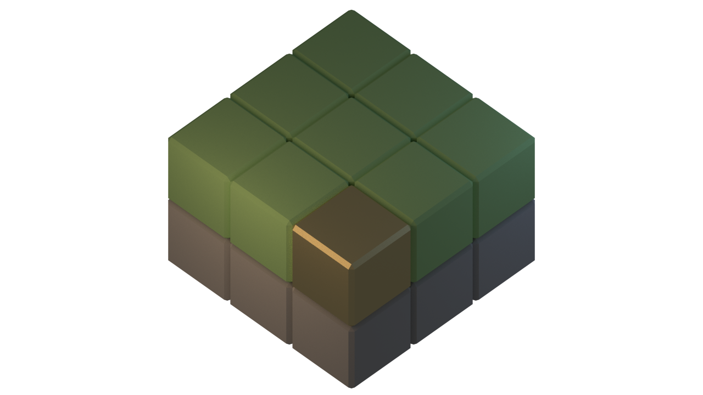

Slide 17
Creating a new file
Open File Browser
Go to Minecraft-Scripts Folder
Copy template.py
Paste in my-scripts and rename (e.g. 1_midastouch.py)
Open the file in IDLE

Slide 18
Running the program
Make sure Minecraft is running (in-world)
Save your file (File -> Save)
Run the Program (Run->Run Module OR Press F5)

Slide 19
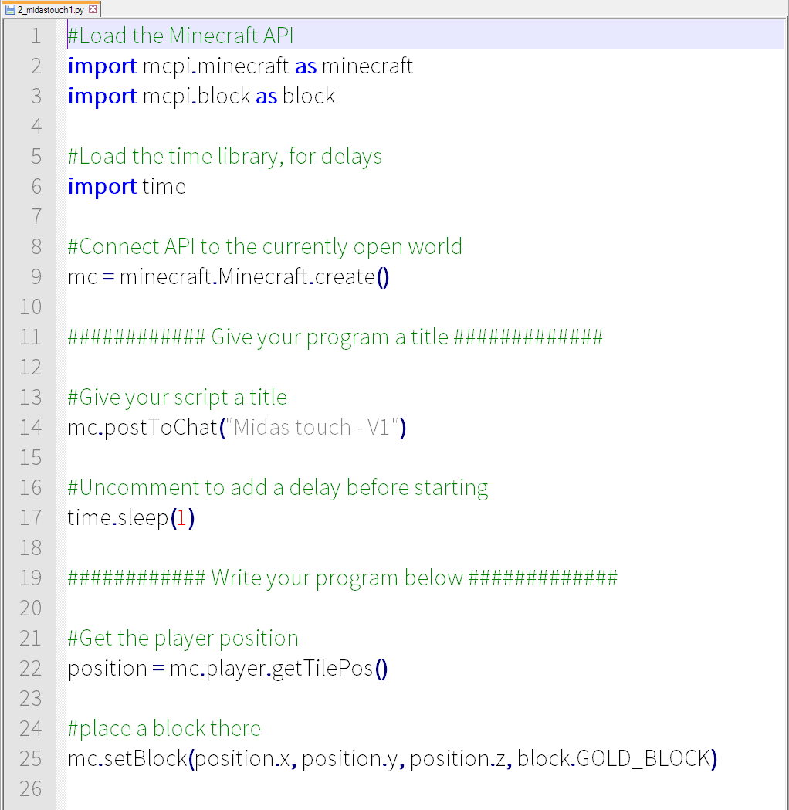
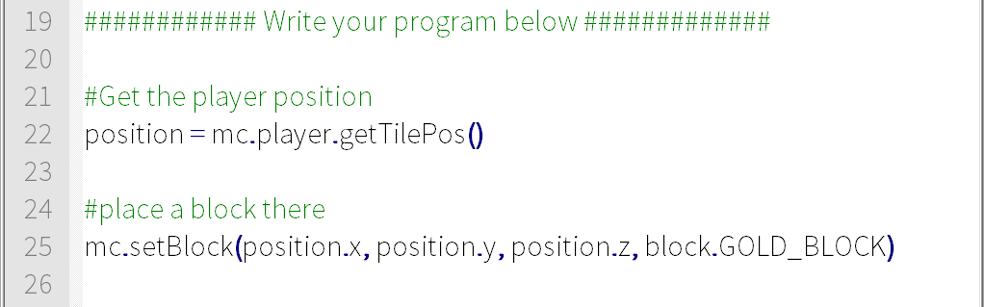
Midas Touch

Slide 21
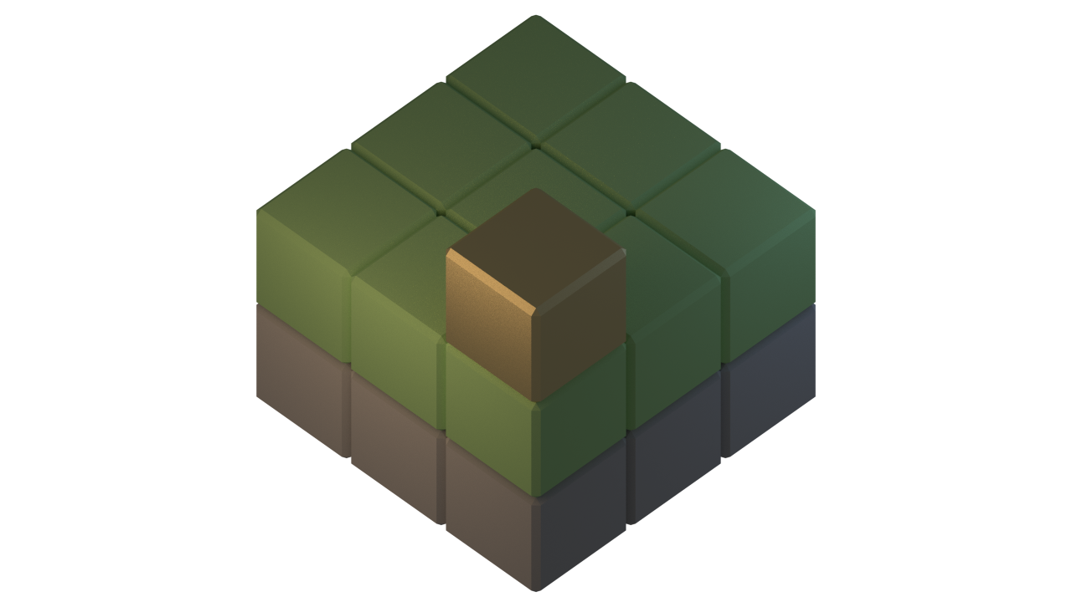

Slide 22
(x, y, z)
Y
X
Z

Slide 23
(0, 2, 0)
Y
X
Z

Slide 24
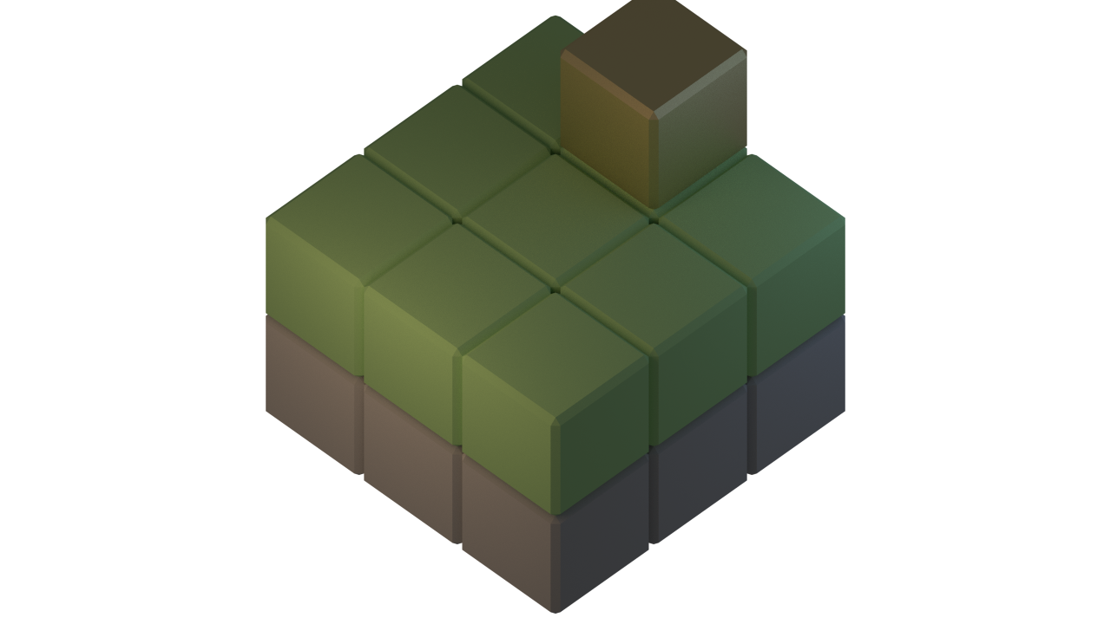
(1, 2, 2)
Y
X
Z

Slide 25
(0, 1, 0)
Y
X
Z

Slide 26
(0, 2, 0)
Y
X
Z

Slide 27
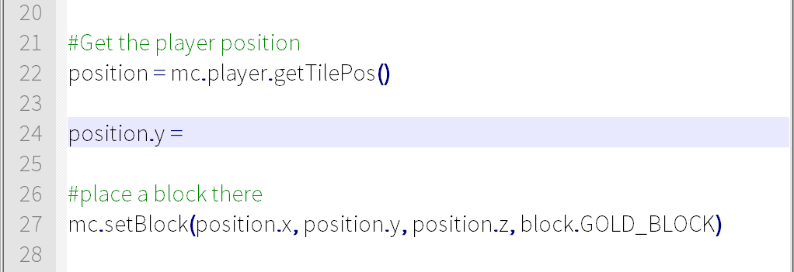
Midas Touch

Slide 28
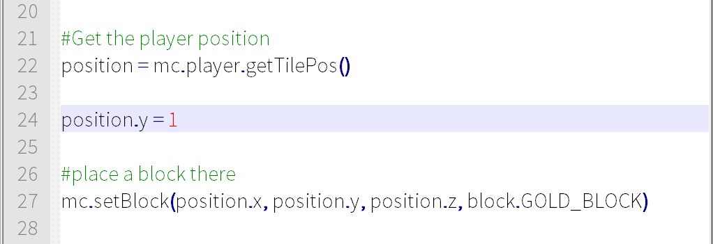
Midas Touch

Slide 29
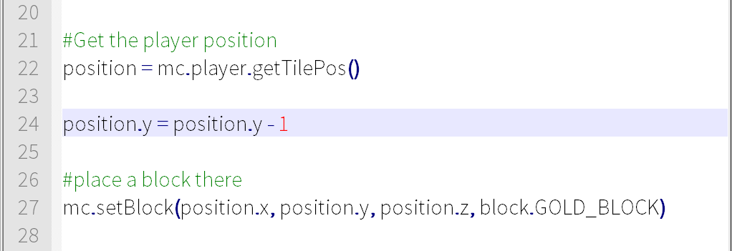
Midas Touch

Slide 30
Midas Touch V2
Keep changing blocks

Slide 31
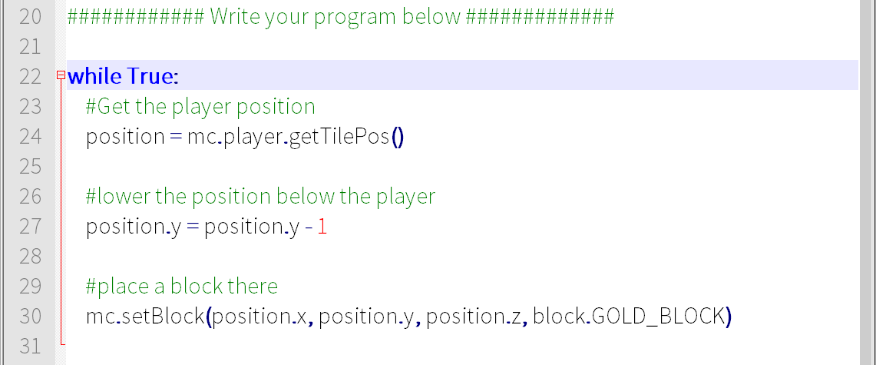
Midas Touch

Slide 32
Midas Touch V3
Don’t change air

Slide 33
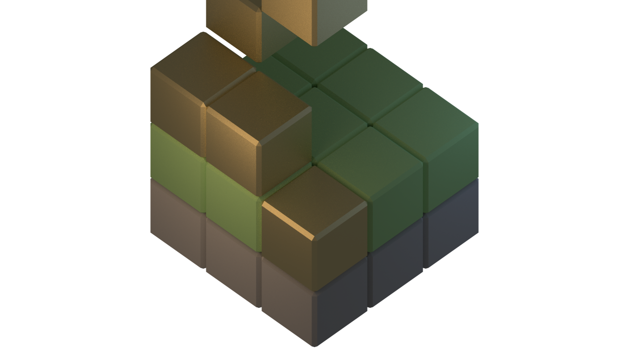

Slide 34
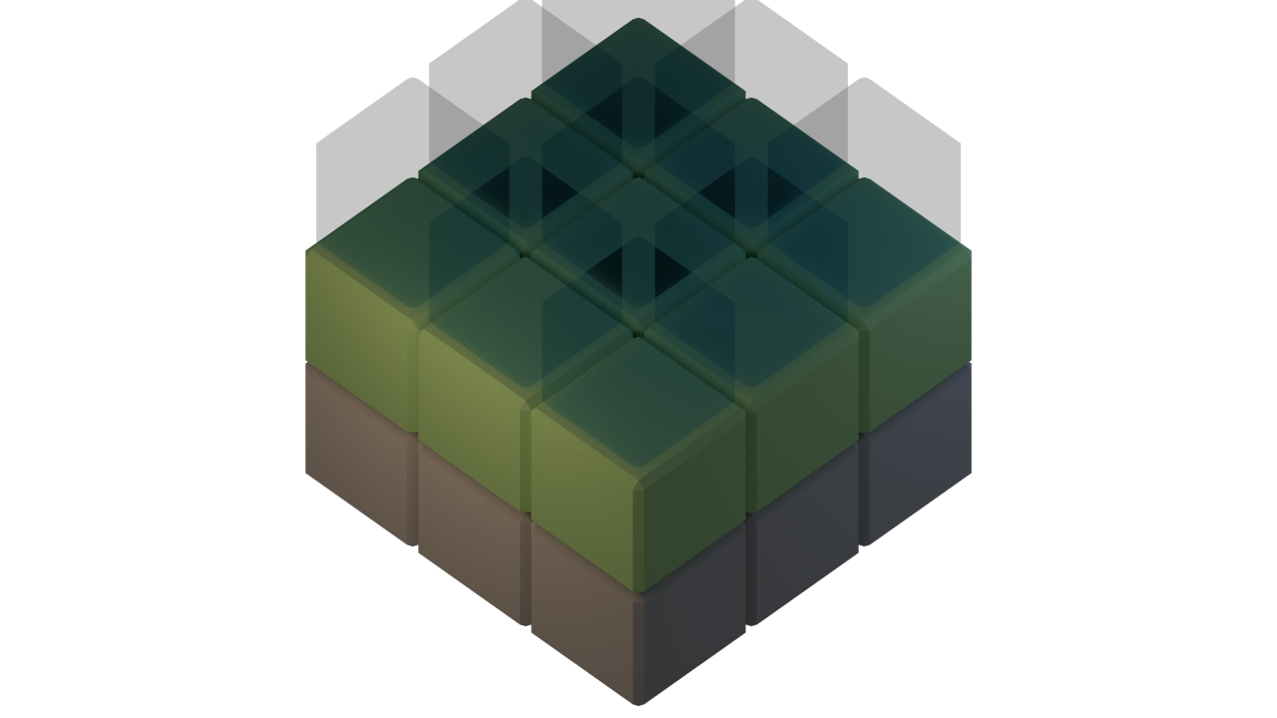

Slide 35
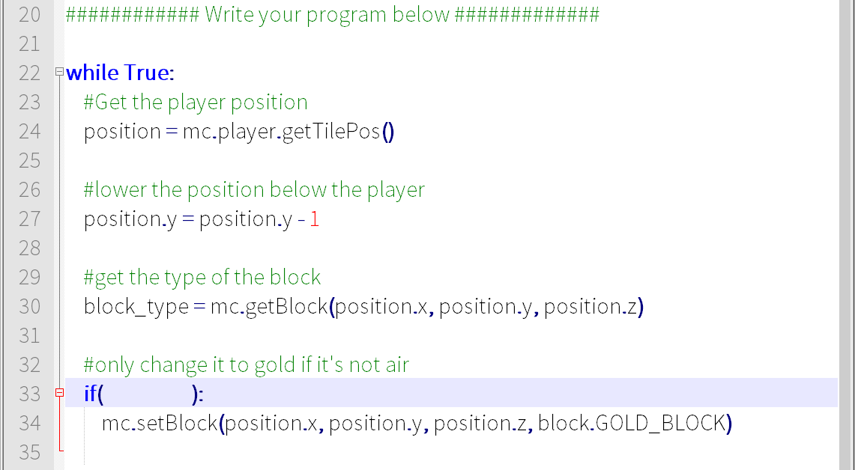
Midas Touch

Slide 36
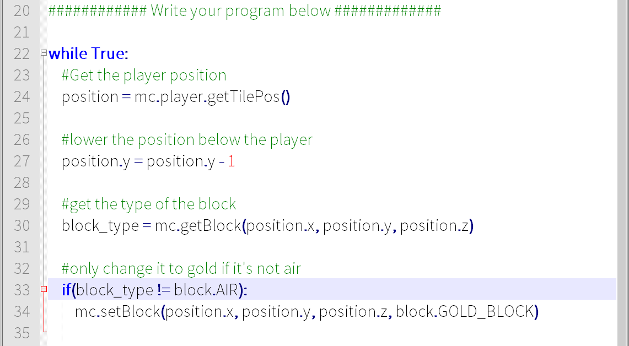
Midas Touch

Slide 37
The sword of exploding TNT
=O

Slide 38
Make a new copy of the template
Open File Browser
Go to Minecraft-Scripts Folder
Copy template.py
Paste in my-scripts and rename (e.g. 2_tnt_sword.py)
Open the file in IDLE

Slide 39
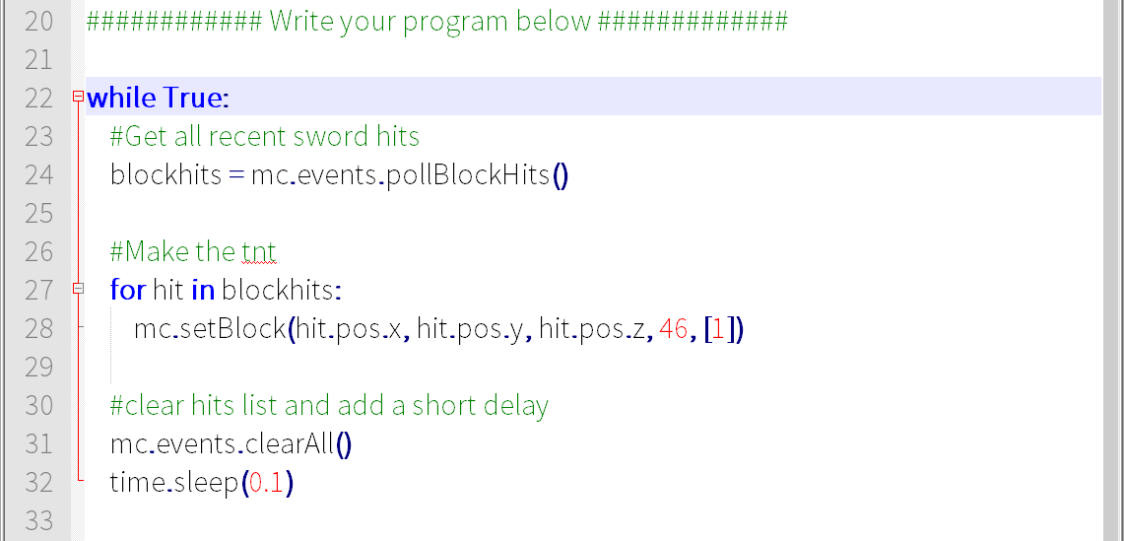
TNT Sword

Slide 40
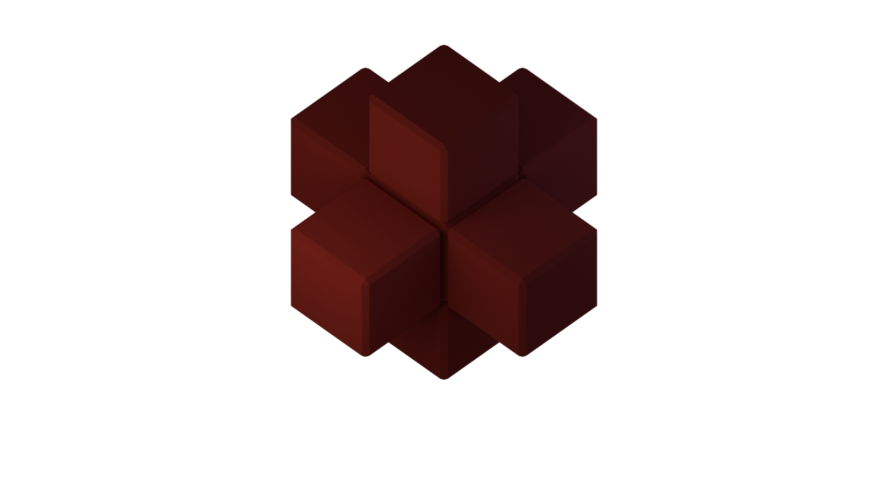

Challenge: Make a bigger explosion
Try and create more than one block of TNT per hit
Hint: mc.setBlock(hit.pos.x+1, hit.pos.y, hit.pos.z, 46, [1])

Slide 43
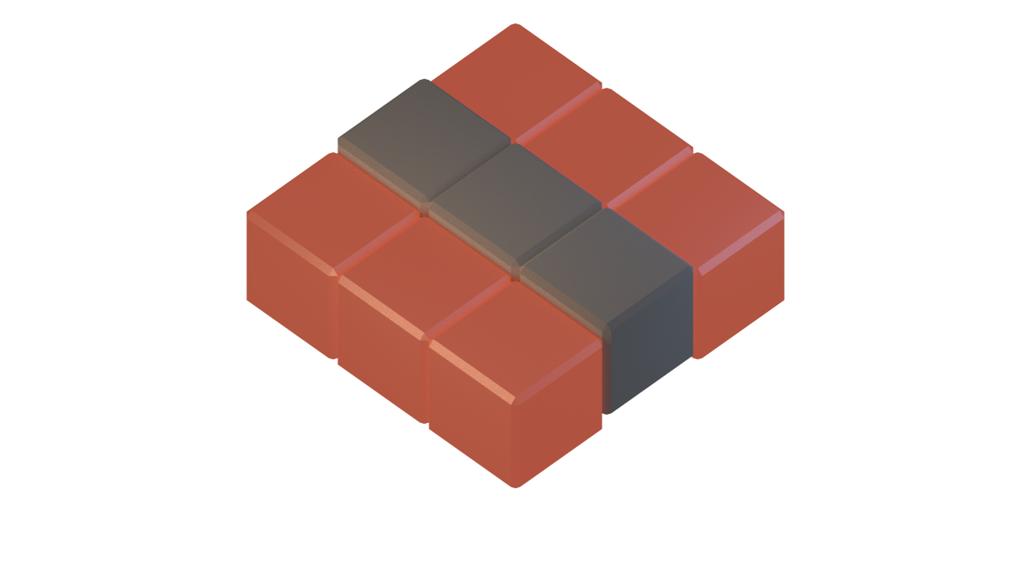
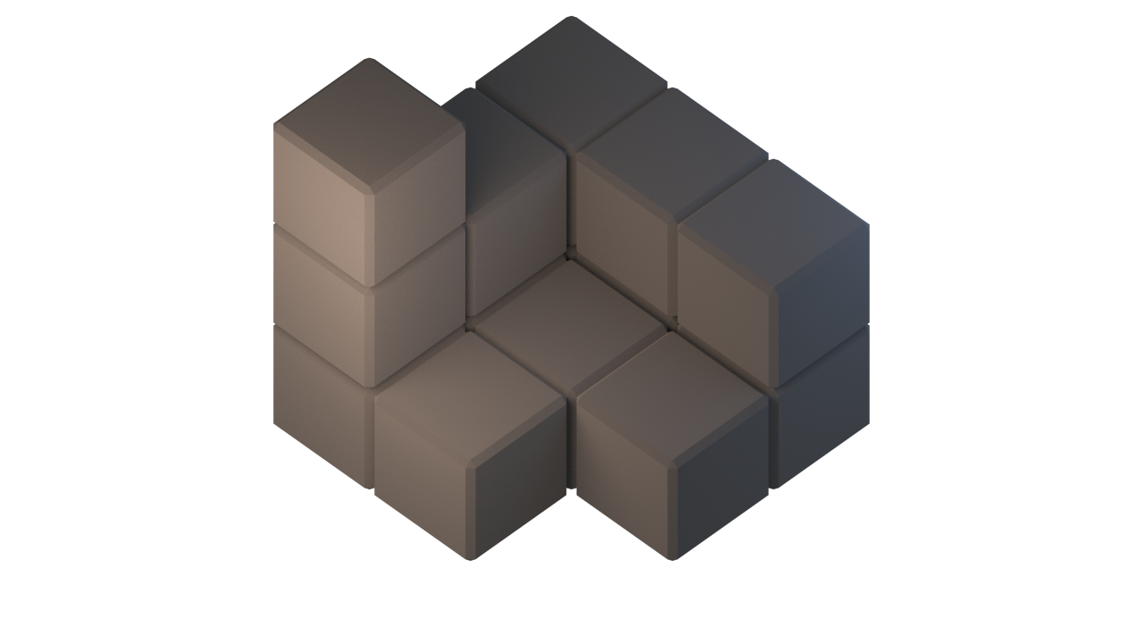

Slide 44
The Rules
The Lava Crossing script and tunneling script must be separate files
stop the first script before starting the second
If you fall in the lava you must restart from the start point
You must stay within the insides of the castle when tunneling

Slide 45
Prizes
Prizes for the first 3 people to make it to the top of the castle
First Prize: A Raspberry Pi 2 Model B

Slide 46
Hints
The midas touch script will work for the lava moat, but try expanding the area it affects to prevent you falling in.
Be careful how you tunnel, digging in front of you will make it difficult to climb upwards

